Slide 1


La importancia de la nutrición en el bienestar de la abeja doméstica
José Serrano
Prof. Emérito, Universidad de Murcia
Facultad de Veterinaria
JORNADAS TÉCNICAS DE APICULTURA DE LA REGIÓN DE MURCIA
6 OCTUBRE 2022

Slide 2
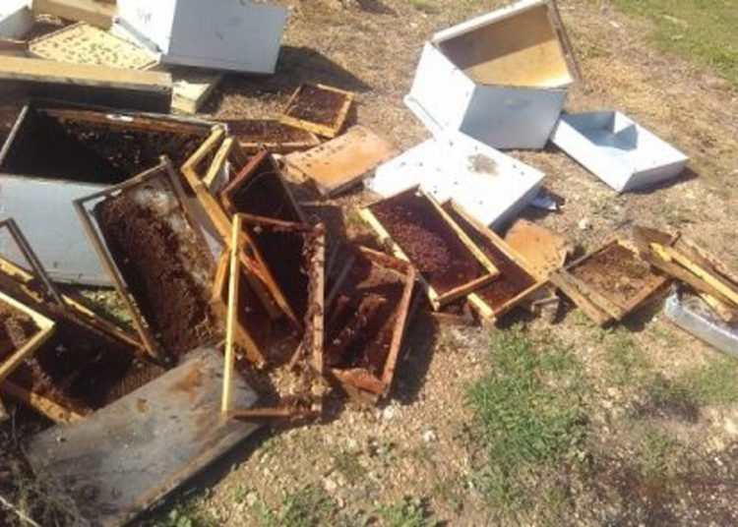
Hay un consenso generalizado sobre el incremento en la mortalidad que sufren las colmenas de España y de gran parte del mundo. Las enfermedades emergentes y la presencia de cantidades cada vez más elevadas de sustancias tóxicas en el medio ambiente son, posiblemente, los dos conjuntos de factores que tienen mayor incidencia en esas pérdidas masivas.

Slide 3
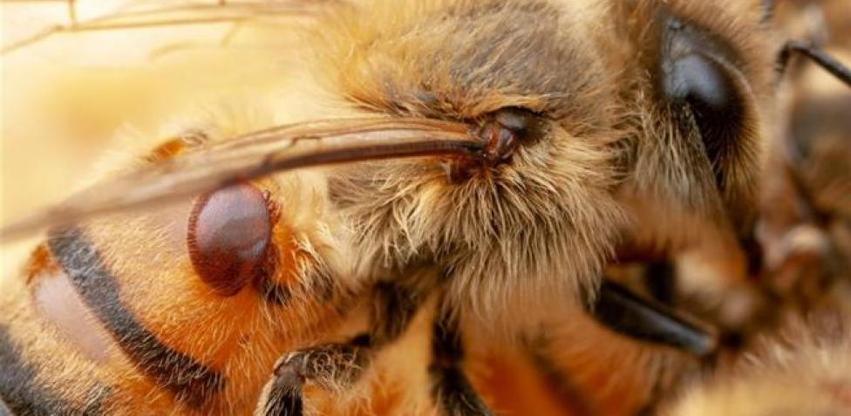
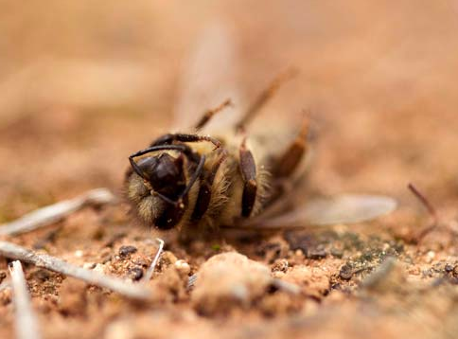
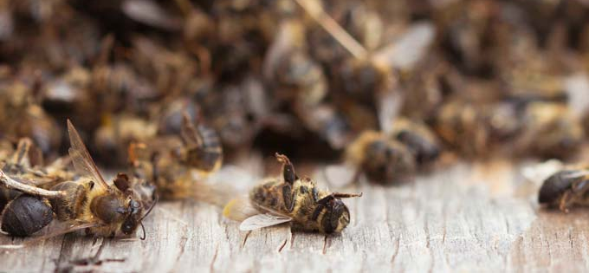
Da la impresión de que las abejas actuales son menos resistentes y más sensibles a los factores adversos a los que se enfrentan. Todos observamos que mientras que algunas colmenas crecen y producen bien, contando con una población numerosa, hay otras cercanas que están como mustias y apenas crecen, incluso en primavera y con abundancia de flores. ¿Qué les está ocurriendo?

Slide 4
El mensaje de esta charla es que:
Las abejas domésticas se están enfrentando a situaciones nuevas de estrés. Uno de los componentes indispensables para resistir estas presiones ambientales es la existencia de un
sistema de defensa eficiente,
tanto a nivel de colmena como del individuo.
La interacción entre pesticidas y susceptibilidad a infecciones:
• Pettis JS, Lichtenberg EM, Andree M, Stitzinger J, Rose R, et al. (2013) Crop pollination exposes honey bees to pesticides which alters their susceptibility to the gut pathogen Nosema ceranae. PLoS ONE 8(7): e70182. doi:10.1371/journal.pone.0070182

Slide 5
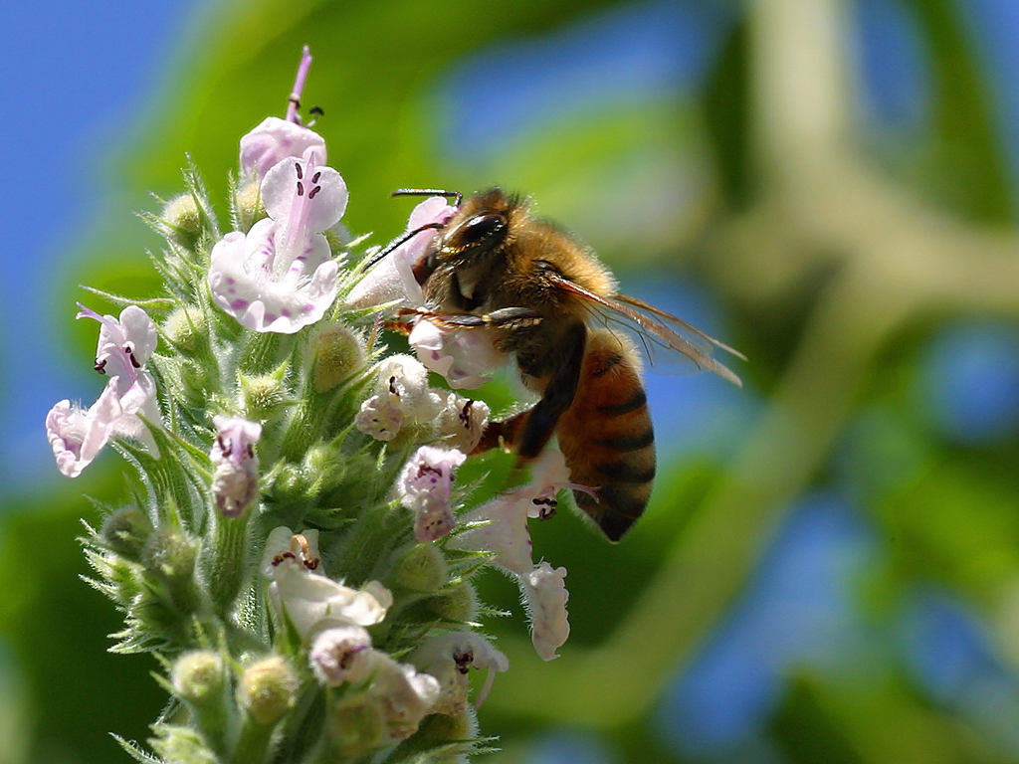
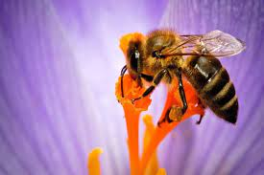
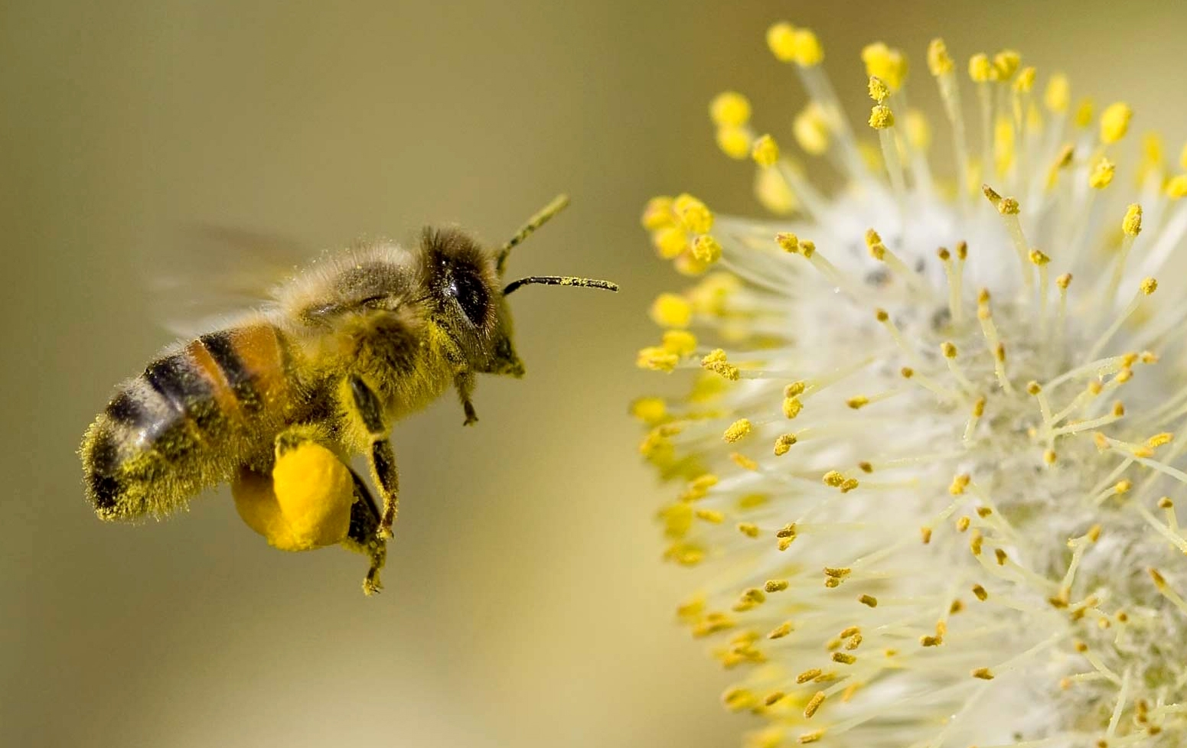
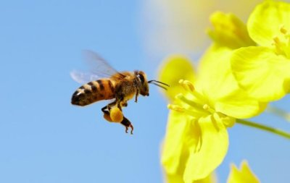
Para que dicho sistema de inmunidad funcione bien, las abejas deben tener una nutrición adecuada, es decir, que sea variada en su origen floral y que esté equilibrada en proteínas y azúcares.

Slide 6
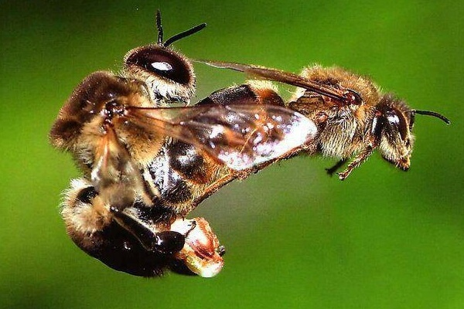
La base genética del sistema inmune de la abeja es importante:
Reina apareada con muchos machos >15-20. Variabilidad genética elevada de la colonia.

Slide 7
Microbiota intestinal en buen estado:

Slide 8
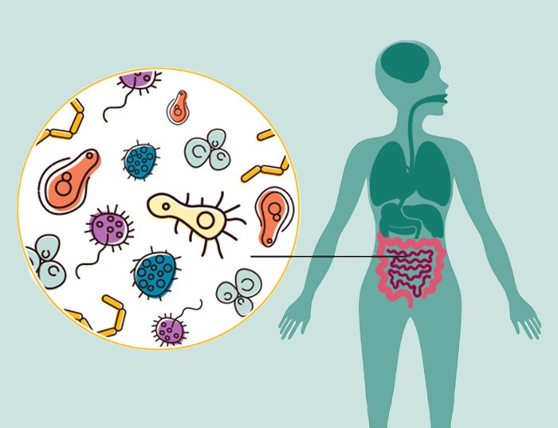
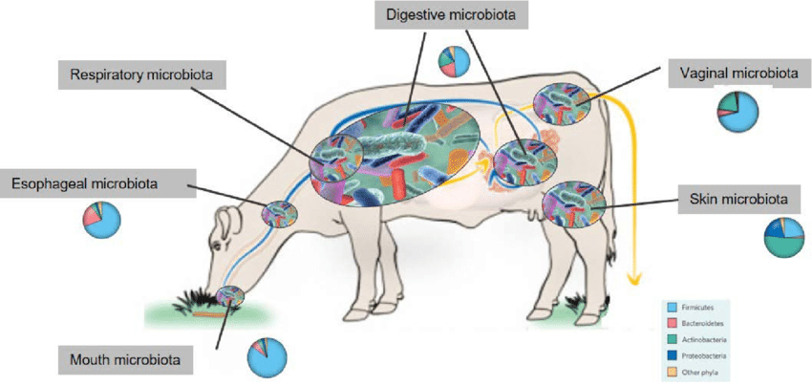
¿Y qué es la microbiota?
Pues el conjunto de microorganismos que coexisten de forma natural con la abeja (y con cualquier otro animal) y tienen relaciones beneficiosas mutuas con su hospedador.
La microbiota se origina a través de interacciones cada vez más estrechas entre hospedador y microorganismos; el proceso tarda en consolidarse miles o millones de años y crea interdependencia mutua: COEVOLUCIÓN

Slide 9
La microbiota INTESTINAL favorece la absorción de nutrientes, y defiende a la abeja frente a microorganismos extraños que pueden ser perjudiciales.
Esta microbiota se altera por:
los antibióticos,
la entrada de otros microorganismos patógenos,
la ingesta de sustancias tóxicas
y una alimentación deficiente en nutrientes básicos.

Slide 10
Los avances recientes muestran una relación estrecha entre alimentación – microbiota – incidencia de enfermedades
La alimentación deficiente perjudica a la microbiota y favorece la progresión de microorganismos parásitos (Varroa destructor) y patógenos (Nosema ceranae, virus).
Naug D. 2009. Nutritional stress due to habitat loss may explain recent honeybee colony collapses. Biological Conservation 142: 2369–2372.
I discuss how increasing loss of foraging resources could be synergistically acting with emerging diseases to stress honeybee populations…

Slide 11
Dussaubat C, Brunet J-L, Higes M, Colbourne JK, Lopez J, et al. (2012) Gut pathology and responses to the microsporidium Nosema ceranae in the honey bee Apis mellifera. PLoS ONE 7(5): e37017. doi:10.1371/journal.pone.0037017:
Finally, a dramatic effect of the microsporidia infection was the inhibition of genes involved in the homeostasis and renewal of intestinal tissues (Wnt signaling pathway), a phenomenon that was confirmed at the histological level. This tissue degeneration and prevention of gut epithelium renewal may explain early bee death.
A. SANDIONIGI, et al. 2015. Towards a better understanding of Apis mellifera and Varroa destructor microbiomes: introducing ‘_{PHYLOH}’ as a novel phylogenetic diversity analysis tool.
Molecular Ecology Resources (2015) 15, 697–710
Our results showed a dramatic change of the honeybee microbiome when varroa occurs, suggesting that this parasite is able to influence host microbiome.

Slide 12
Microbioma de la abeja y de su parásito Varroa.
Efectos de la infestación de Varroa en la abeja.
A. SANDIONIGI, et al. 2015
larva sana
larva infestada por Varroa
intestino de Varroa

Slide 13
Dolezal AG, et al. 2019 Interacting stressors matter: diet quality and virus infection in honeybee health. R. Soc. open sci. 6: 181803. http://dx.doi.org/10.1098/rsos.181803
we found that high-quality diets (polyfloral pollen and high-quality single source pollen) have the potential to reduce mortality in the face of infection with Israeli acute paralysis virus (IAPV). There was a significant interaction between diet and virus infection on mortality, even in the presence of high virus titres, suggesting that good diets can help bees tolerate virus infection.
L. Castelli & B. Branchiccela et al. 2020. Impact of nutritional stress on honeybee gut microbiota, immunity, and Nosema ceranae infection. Microbial Ecology https://doi.org/10.1007/s00248-020-01538-1
Honeybee colony may be affected by nutritional stress. This nutritional stress is related to the increase in monoculture areas which leads to a reduction of pollen availability and diversity. In this study, we examined whether nutritional stress affects honeybee gut microbiota, bee immunity, and infection by Nosema ceranae, under laboratory conditions.
Honeybees feed with Eucalyptus grandis pollen showed a lower abundance of Lactobacillus mellifer and Lactobacillus apis (Firm-4 and Firm-5, respectively) and Bifidobacterium spp. and a higher abundance of Bartonella apis, than honeybees fed with polyfloral pollen. Besides the impact of nutritional stress on honeybee microbiota, it also decreased the expression levels of vitellogenin and genes associated to immunity (glucose oxidase, hymenoptaecin and lysozyme). Finally, Eucalyptus grandis pollen favored the multiplication of Nosema ceranae.

Slide 14
Tejerina M.R. & Benítez-Ahrendts M.R. & Audisio M.C. 2020. Lactobacillus salivarius A3iob reduces the incidence of Varroa destructor and Nosema sp. in commercial apiaries located in the northwest of Argentina. Probiotics Antimicrob Proteins. 2020 Dec;12(4):1360-1369.
Lactobacillus salivarius A3iob was administered to productive colonies belonging to commercial apiaries of small beekeepers (around 30–50 hives each one), from four departments of the province of Jujuy (Argentina): Yala, Tilquiza, El Carmen, and Los Alisos. The incidence of Varroa destructor and Nosema spp., before and after winter, was monitored during 2 years of study (2014–2015). Depending on the geographical location of each apiary and the application time, a monthly dose of the bacteria (105 CFU/mL) reduced the levels of varroasis between 50 and 80%. Interestingly, L. salivarius A3iob cells remitted the percentage of the mites to undetectable values in an apiary treated with flumethrin (at Yala, Yungas region). On the other hand, the spore levels of Nosema spp. in the lactobacilli-treated colonies also depended on the apiary and the year of application, but a significant decrease was mainly observed in the post-winter period. However, at Rivera (El Carmen’s department), no significant changes were detected in both parameters. These results obtained after 2 years of work suggest that delivering L. salivarius A3iob cells to the bee colonies can become a new eco-friendly tool to cooperate with the control of these bees’ pests.

Slide 15
En definitiva, las investigaciones recientes nos están enseñando las relaciones siguientes:
diversidad genética elevada reina
productos tóxicos, malnutrición
menos pérdidas
COLMENA:
defensa social e individual eficiente
mayor resistencia frente a factores de estrés
NUTRIENTES + PROBIÓTICOS: alimentación suplementaria
mayores producciones
Varroa, Nosema, virus, Penibacillum
microbiota natural sana

Slide 16
En definitiva: es bueno dar probióticos con alimentación suplementaria bien escogida:
Antes de la invernada.
Antes de arrancar la floración primaveral.
Desde que empieza el otoño . . .

Slide 17
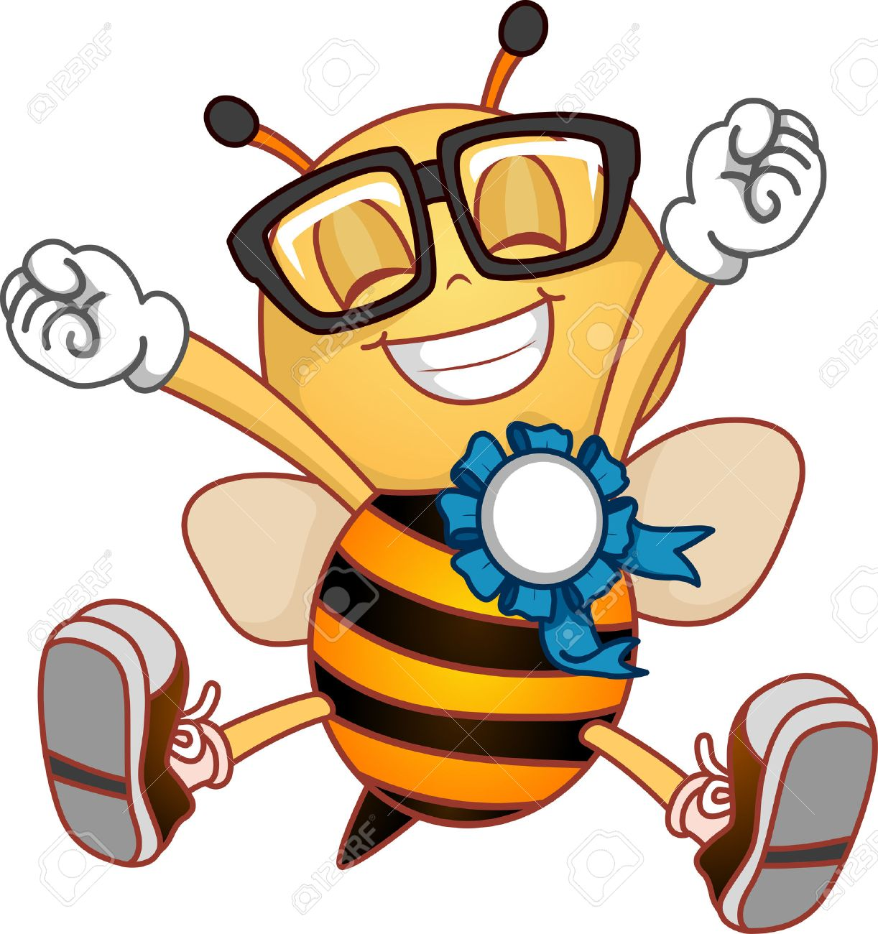


Slide 18
A continuación, bibliografía extra para ampliar información
Ahmad, S., Khan, K. A., Khan, S. A., Ghramh, H. A., y Gul, A. (2021). Comparative assessment of various supplementary diets on commercial honey bee (Apis mellifera) health and colony performance. PLoS One, 16(10): e0258430.
Audisio, M. C. & Benítez-Ahrendts, M. R. (2011). Lactobacillus johnsonii CRL1647, isolated from Apis mellifera L. bee-gut, exhibited a beneficial effect on honeybee colonies. Benef. Microbes, 2: 29-34.
Basualdo, M., Barragán, S. & Antúnez, K. (2014). Bee bread increases honeybee haemolymph protein and promote better survival despite of causing higher Nosema ceranae abundance in honeybees. Environ. Microbiol. Rep., 6(4): 396-400.
Bogdanov, S. (2004). Quality and standards of pollen and beeswax. Apiacta, 38: 334-341.
Borges, D., Guzman-Novoa, E. & Goodwin, P. H. (2021). Effects of prebiotics and probiotics on honey bees (Apis mellifera) infected with the microsporidian parasite Nosema ceranae. Microorganisms, 9(3): 481.

Slide 19
Brodschneider, R. & Crailsheim, K. (2010). Nutrition and health in honey bees. Apidologie, 41: 278-294.
D'Alvise, P., Böhme, F., Codrea, M. C., Seitz, A. & Hasselmann, M. (2018). The impact of winter feed type on intestinal microbiota and parasites in honey bees. Apidologie, 49(2): 252-264.
Danihlík, J., Skrabisová, M., Lenobel, R., Sebela, M., Omar E., Petřivalský M., Crailsheim K. & Brodschneider, R. (2018). Does the pollen diet influence the production and expression of antimicrobial peptides in individual honey bees? Insects, 9(3): 79.
De Groot, A. P. (1953). Protein and amino acid requirements of the honeybee (Apis mellifera L.). In Physiol. Comp. Oecol., chapter 3, pages 197-285. Junk, den Haag.
DeGrandi-Hoffman, G., Chen, Y., Huang, E. & Huang, M. H. (2010). The effect of diet on protein concentration, hypopharyngeal gland development and virus load in worker honey bees (Apis mellifera L.). J. Insect Physiol., 56: 1184-1191.
DeGrandi-Hoffman, G., Gage, S. L., Corby, H. V., Carroll, M. & Ziolkowski, N. (2018). Connecting the nutrient composition of seasonal pollens with changing nutritional needs of honey bee (Apis mellifera L.) colonies. J. Insect Physiol., 109: 114-124.

Slide 20
Descamps, C., Quinet, M. & Jacquemart, A. L. (2021). Climate change-induced stress reduce quantity and alter composition of nectar and pollen from a bee-pollinated species (Borago officinalis, Boraginaceae). Front. Plant Sci., 12: 755843.
Di Pasquale, G., Alaux, C., Le Conte, Y., Odoux, J. F., Pioz, M., Vaissière, B. E., Belzunces, L. P. & Decourtye, A. (2016). Variations in the availability of pollen resources affect honey bee health. PLoS One, 11(9): e0162818.
Di Pasquale, G., Salignon, M., Le Conte, Y., Belzunces, L. P. & Alaux, C. (2013). Influence of pollen nutrition on honey bee health: Do pollen quality and diversity matter? PLoS One, 8(8): e72016.
Didaras, N. A., Karatasou, K., Dimitriou, T. G., Amoutzias, G. D. & Mossialos, D. (2020). Antimicrobial activity of bee-collected pollen and beebread: State of the art and future perspectives. Antibiotics, 9(11): 811.

Slide 21
Evans, J. D. & Lopez, D. L. (2004). Bacterial probiotics induce an immune response in the honey bee (Hymenoptera: Apidae). J. Econ. Entomol., 97(3): 752 756.
Evans J.D. & Spivak M. (2010). Socialized medicine: Individual and communal disease barriers in honey bees. J. Invert. Pathol., 103: 62–72.
Feas, X., Vazquez, T. M. P., Estevinho, L., Seijas, J. A. & Iglesias, A. (2012). Organic bee pollen: botanical origin, nutritional value, bioactive compounds, antioxidant activity and microbiological quality. Molecules, 17: 8359-8377.
Gérard, M., Vanderplanck, M., Wood, T. & Michez, D. (2020). Global warming and plant-pollinator mismatches. Emerging Top. Life Sci., 4: 77-86.
Huang, Z. (2012). Pollen nutrition affects honey bee stress resistance. Terr. Arthr. Rev., 5(2): 175-189.
Keller, I., Fluri, P. & Imdorf, A. (2005). Pollen nutrition and colony development in honey bees: Part I. Bee World, 86(2): 3-10.
Kešnerová, L., Mars, R. A., Ellegaard, K. M., Troilo, M., Sauer, U. & Engel, P. (2017). Disentangling metabolic functions of bacteria in the honey bee gut. PLoS Biol., 15(12): e2003467.
Li, C., Xu, B., Wang, Y., Feng, Q. & Yang, W. (2012). Effects of dietary crude protein levels on development, antioxidant status, and total midgut protease activity of honey bee (Apis mellifera ligustica). Apidologie, 43(5): 576-586.

Slide 22
Ptaszyńska, A. A., Borsuk, G., Zdybicka-Barabas, A., Cytryńska, M. & Malek, W. (2016). Are commercial probiotics and prebiotics effective in the treatment and prevention of honeybee nosemosis C? Parasitol. Res., 115: 397-406.
Sabaté, D. C., Cruz, M. S., Benítez-Ahrendts, M. R. & Audisio, M. C. (2012). Beneficial effects of Bacillus subtilis sub sp. subtilis Mori2, a honey-associated strain, on honeybee colony performance. Probiot. Antimicrob. Prot., 4: 39-46.
St. Clair, A. L., Zhang, G., Dolezal, A. G., O'Neal, M. E. & Toth, A. L. (2020). Diversified farming in a monoculture landscape: Effects on honey bee health and wild bee communities. Environ. Entomol., 49(3): 753-764.
Szymas, B. & Jedruszuk, A. (2003). The influence of different diets on haemocytes of adult worker honey bees, Apis mellifera. Apidologie, 34: 97-102.
Villagomez, G. N., Nürnberger, F., Requier, F., Schiele, S. & Steffan-Dewenter, I. (2021). Effects of temperature and photoperiod on the seasonal timing of western honey bee colonies and an early spring flowering plant. Ecol. Evol., 11(12): 7834-7849.
Wenfeng Li, Yanping Chen, Steven C. Cook . 2017. ⇑ https://doi.org/10.1016/j.ijpara.2017.11.004 0020-7519/Published by Elsevier Ltd on behalf of Australian Society for Parasitology. ⇑. Chronic Nosema ceranae infection inflicts comprehensive and persistent immunosuppression and accelerated lipid loss in host Apis mellifera honey bees.

Slide 23
LoCascio, G. M., Aguirre, L., Irwin, R. E. & Adler, L. S. (2019). Pollen from multiple sunflower cultivars and species reduces a common bumblebee gut pathogen. R. Soc. Open Sci., 6: 190279.
Manning, R. (2016). Artificial feeding of honeybees based on an understanding of nutritional principles. Anim. Prod. Sci., 58(4): 689-703.
Markowiak, P. & Slizewska, K. (2018). The role of probiotics, prebiotics and symbiotics in animal nutrition. Gut Pathog., 10: 21.
Mishukovskaya, G., Giniyatullin, M., Tuktarov, V., Khabirov, A., Khaziahmetov, F. & Naurazbaeva, A. (2020). Effect of probiotic feed additives on honeybee colonies overwintering. Am. J. Anim. Vet. Sci., 15(4): 284-290.
Negri, P., Maggi, M., Ramirez, L., Szawarski, N., De Feudis, L., Lamattina, L. & Eguaras, M. (2016). Cellular immunity in Apis mellifera: studying hemocytes brings light about bee’s skills to confront threats. Apidologie, 47(3): 379-388.
Negri P., Villalobos E., Szawarski N., Damiani N., Gende L., Garrido M., Maggi M., Quintana S., Lamattina L., & Eguaras M. (2019). Towards precision nutrition: a novel concept linking phytochemicals, immune response and honey bee health. Insects, 10: 29 pp. doi:10.3390/insects10110401

Slide 24
Wilson, R. N., Dres, S. T. & Starks, P. T. (2008). The ontogeny of immunity: development of innate immune strength in the honey bee (Apis mellifera). J. Insect Physiol., 54: 1392-1399.
Wright, G. A., Nicolson, S. W. & Shafir, S. (2018). Nutritional physiology and ecology of honey bees. Annu. Rev. Entomol., 63: 327-344.
Yirga, H. (2015). The use of probiotics in animal nutrition. J. Probiotics Heal., 3(2): 10 pp. DOI: 10.4172/2329-8901.1000132
Zheng, B., Wu, Z. & Xu, B. (2014). The effects of dietary protein levels on the population growth, performance, and physiology of honey bee workers during early spring. J. Insect Sci., 14(191).

